Slide 1
High-throughput and Adaptive Feedback Microscopy
Christian Tischer, Sabine Reither, Volker Hilsenstein, Beate Neumann, Rainer Pepperkok
Advanced Light Microscopy Facility, EMBL Heidelberg
Meyerhofstr.1, 69117 Heidelberg, Germany
High-throughput microscopy of siRNA treated cells has become a standard tool for discovering genes with roles in specific biological processes. However, conducting high-throughput microscopy experiments is still challenging as it puts high demands on sample preparation, microscopy, image and data analysis. Moreover, further characterization of the “hit genes” often requires demanding microscopic assays that are difficult to perform even in medium throughput. In this talk, I will outline the typical challenges occurring in high-throughput microscopy and discuss how dedicated microscope systems can help to tackle these challenges. In addition, I will describe how “adaptive feedback microscopy” allows scientist to perform highly complex microscopic assays in a fully automated manner, thereby enabling detailed and systematic further investigation of the identified “hit genes”.

Slide 2
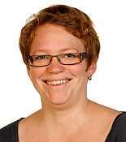
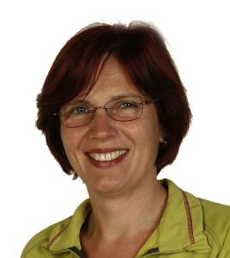
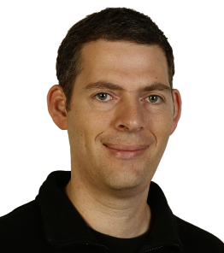
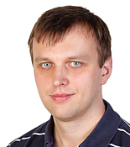
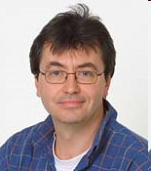
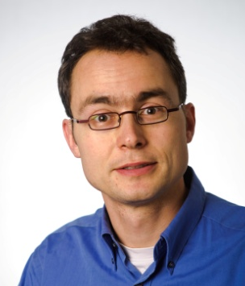
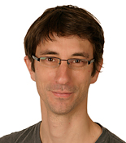
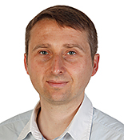
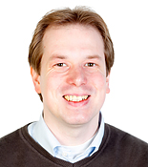
Advanced Light Microscopy Facility (ALMF) at EMBL Heidelberg, Germany
Since 1998 serving EMBL scientists and international visitors
High-Throughput Microscopy
Advanced Light Microscopy
Head of Facility
Sabine Reither
Beate Neumann
Stefan Terjung
Aliaksandr Halavatyi
Rainer Pepperkok
Volker Hilsenstein
Christian Tischer
Tobias Rasse
Marko Lampe

Slide 3
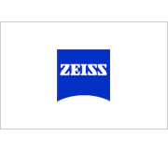
This ‘tech-talk’ is for…
…scientists considering high-throughput microscopy experiments, looking for some advice regarding
Microscope system considerations
Assay development
Data analysis
Invited by

Slide 4
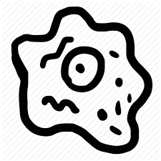
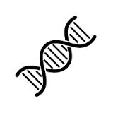



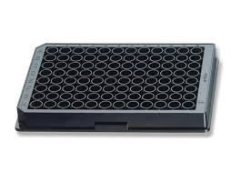
A ‘typical’ HT-microscopy screen
Biological process
Find novel genes
?
~40000 images
20x lens
2 channels
4 positions per well
Bioinformatic filter
~500 putative genes
Image analysis of
~4 million cells
~1500 siRNAs (3 per gene)
Statistics
~54 96-well plates (3 replicates)
List of “hit” genes
!

Slide 5
Microscope system considerations

Slide 6
Auto-focus Modalities
Pro:
Fast (<<1s)
Good for sample
Con:
Requires constant sample z-position
Requires presence of reflective surface
fixed offset
“Software” autofocus
Fluorescence z-stack imaging finding highest contrast plane
“Hardware” autofocus
Finding coverslip surface reflection using far-red light
Can be fast: <<1s
“Software” autofocus
Fluorescence z-stack imaging finding highest contrast plane
Typically (much) slower
Bleaching of the sample
Pro:
Can deal with samples at different z-positions
Con:
Slow (>>1s)
Not good for sample (bleaching)
Can get confused if objects are in multiple planes
Notes:
Pro:
Can deal with samples at different z-positions
Con:
Slow (>>1s)
Not good for sample (bleaching)
Can get confused if objects are in multiple planes
Pro:
Faster (<<1s)
Better for sample
Con:
Requires constant sample z-position
Requires presence of reflective surface

Slide 7



Multi-color Imaging Modalities
Halogen
lamp
LED
~ 0 s
Multi-band dichroic
Filter cube
>100 ms
Emission filter wheel >10 ms
Faster, no crosstalk
~100ms
~100ms
Simultaneous imaging for fastest speeds
$$
LED
~ 0 s
Multi-band dichroic
LED
~ 0 s
Multi-band dichroic
Crosstalk?!
Multi-band emission filter
Crosstalk?!
~100ms

Slide 8
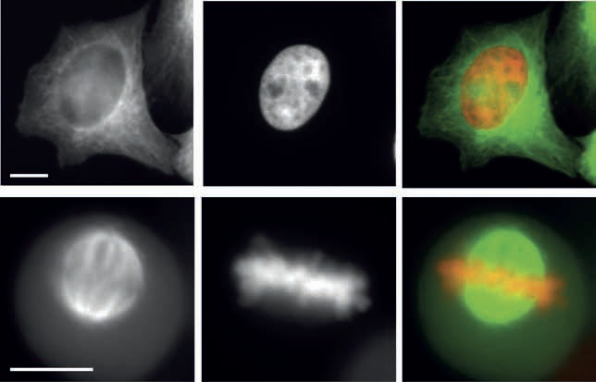
Sample mounting
GFP-Tubulin
Hb2-mCherry
Merge
Interphase
Plate bottom | Cell growth | Price | Imaging quality
Plastic | + | ~2 $ | o,+
Glass | o | ~10 $ | ++
Mitosis
Zeiss CellObserver 7, 40x magnification, NA0.7
Imaged through 1mm plastic bottom

Slide 9
Multi-well Transmission Imaging
Brightfield contrast
Condenser lens
“Phase gradient contrast”
!
!
Zeiss CellDiscoverer 7, 5x magnification

Slide 10
Acquisition Modality Considerations

Slide 11
Confocal stacks
10 um
z
Point scanning confocal
Spinning disc confocal
Typically too slow
Quite fast (>=1s per stack)
but 3-D data
and 3-D analysis
on-the-fly sum projection
10x less data, simpler 2D analysis

Slide 12
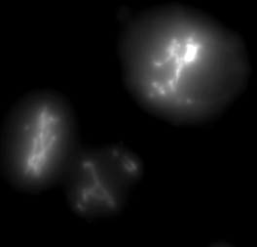
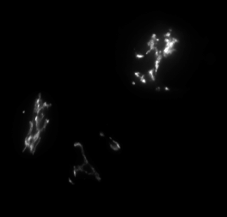
Widefield stack with high NA lens
Zeiss CellDiscoverer 7 Golgi-GFP, cropped image
Sum projection
z-stack, dz=1 um
Widefield NA0.9
Sum projection after deconvolution
Morphology: ok
Intensities: ?
10 um

Slide 13
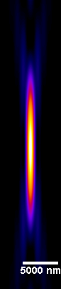
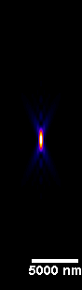
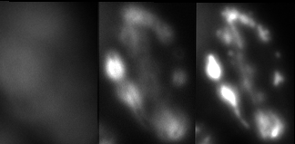
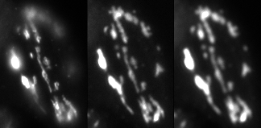
Wide-field single plane with low NA lens
NA 0.3
NA 0.9
Zeiss CellDiscoverer 7 (adaptable NA)
Hela cell, Golgi-GFP
z-stack
1um steps
z
Central plane
Widefield NA0.3
Whole cell in focus in one single image
NA 0.8
80 ms
30% light
NA 0.35
150 ms
40% light
NA 0.26
380 ms
80% light

Slide 14
Image analysis, quality control and statistics

Slide 15

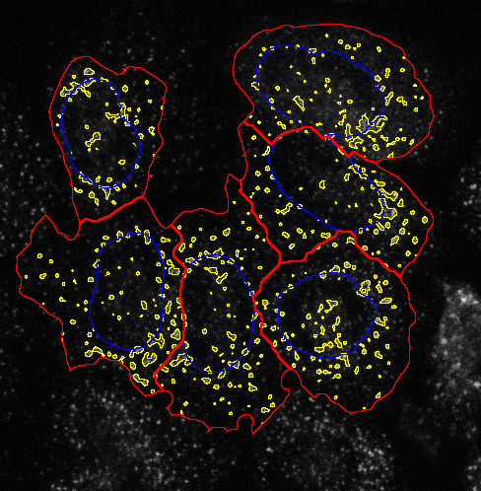
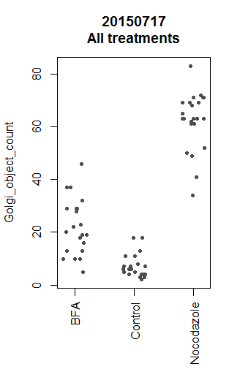
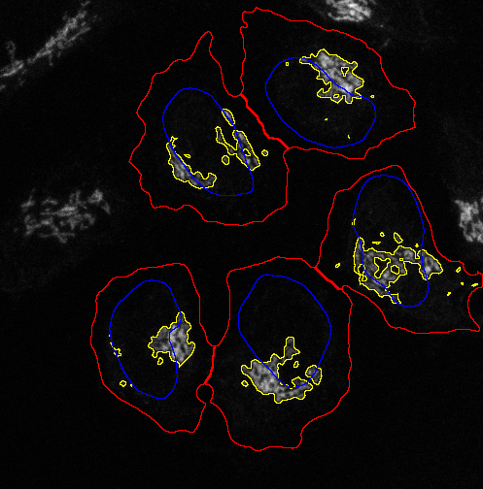
Image analysis, Visual inspection and Statistics
Integrated solution from one company
Gene
Hit
List
Image analysis
Visual inspection
Statistics
Pro:
Least IT hassle
Turn-key solutions for some standard assays
Con:
If a specific image analysis or statistics module is missing it might be difficult to add
+
+
+

Slide 16

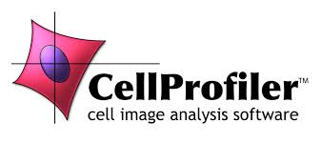

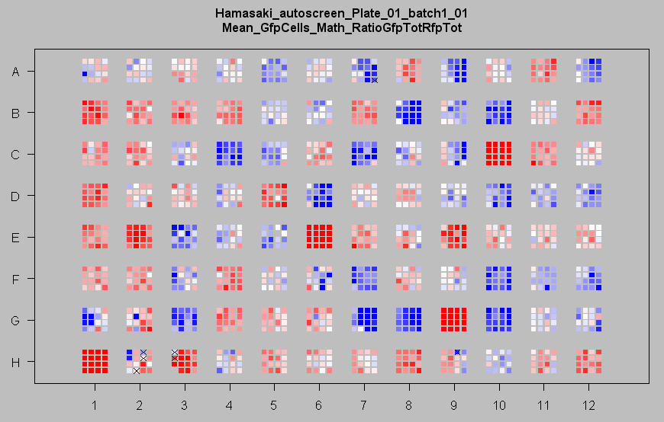
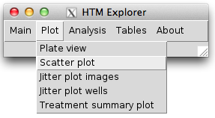
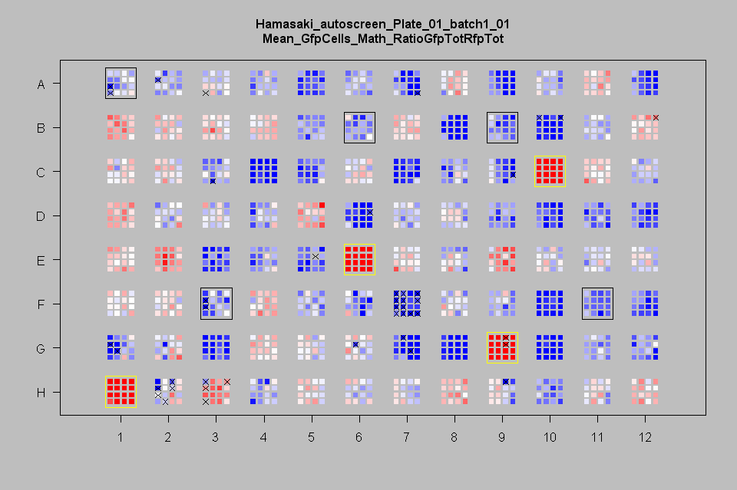

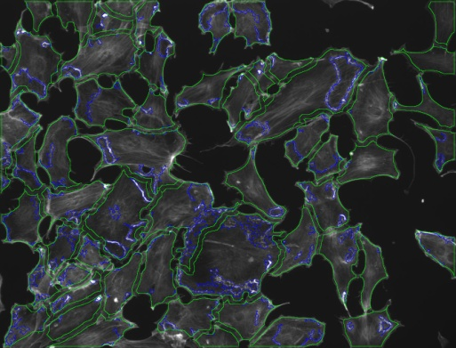
Image analysis, Visual inspection and Statistics
Different
companies
Tiff images with defined naming scheme (“raw data”)
20000 image sets
=> 1000 parallel jobs
20 image sets per job
<1h total analysis time
File conversion and renaming
Linux Compute Cluster
Segmentation images
+ Table (txt file)
+
Gene
Hit
List
+
+
Simple Laptop
‘HTM-Explorer’ R and ImageJ

Slide 17

List of interesting genes … and now?
Most interesting gene => PhD project
Bio-informatic network analysis
High-content ‘secondary’ screens
High-resolution time-lapse
Fluorescence recovery after photo-bleaching (FRAP)
Fluorescence cross correlation spectroscopy (FCS)
Systematically performing such high-content experiments often strongly benefits from “Adaptive Feedback Microscopy”

Slide 18
Adaptive Feedback Microscopy Intelligent Microscopy Smart Microscopy Open Application Development (OAD) [Zeiss]
Todo:
add references
Look for more synonyms
Adapted settings
Analyze data
Conrad et al., Nature Methods (2011)
Tischer et al., Methods Cell Biol. (2014)
Scherf & Huisken, Nature Biotechnology (2015)

Slide 19
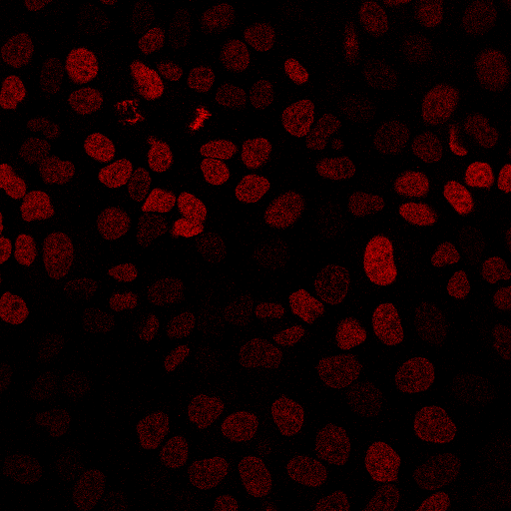
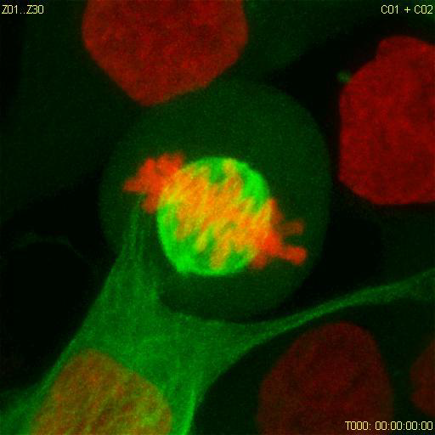
Adaptive Feedback for High-resolution Time-lapse Imaging
Move to pre-defined position
Acquire low-res image
H2B-mCherry (DNA)
single plane
Find mitotic cell by automated analysis
x, y
x=150 y=80
Zoom in on target object
Acquire high-content data
Conrad et al., Nature Methods (2011)

Slide 20
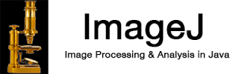
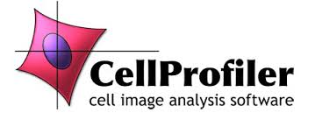
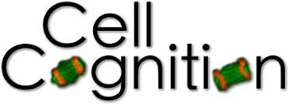
Zeiss ZEN Blue (e.g., LSM 800, CellDiscoverer 7)
Python Programming Interface
Zen Blue Image Analysis Modules
Todo:
add references
Look for more synonyms
ImageJ
CellProfiler
CellCognition

Slide 21
Zeiss AIM (LSM 510)
Zeiss ZEN Black (e.g., LSM 780, LSM 880)
Visual Basic Programming Interface
Custom written visual basic
“Pipeline constructor” [1]
(Antonio Politi, Jan Ellenberg)
Todo:
add references
Look for more synonyms
ImageJ
CellProfiler
CellCognition
[1] Rabut and Ellenberg, Automatic real-time three-dimensional cell tracking by fluorescence microscopy. J. Microscopy, 2004

Slide 22
Automated FRAP Microscopy on ER Exit Sites
Aliaksandr Halavatyi
Move to next grid position
Zeiss LSM780
Also automated FCS experiments are possible
Visual Basic
ImageJ
Tischer et al., Adaptive Feedback Microscopy (2014) Methods in Cell Biology
Halavatyi et al., High-throughput Microscopy (2016) GIT Imaging and Microscopy

Slide 23
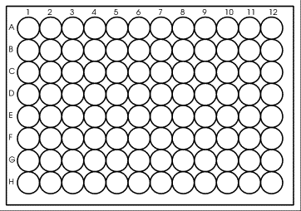
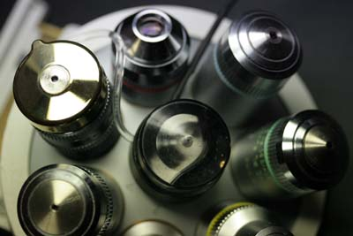
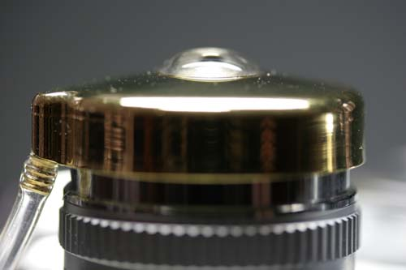
FRAP and FCS => high resolution => high NA => immersion lenses
96-well imaging plate
Automated immersion
(oil and water)
~ 13 cm

Slide 24


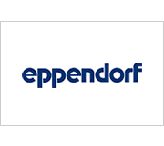















Current Industrial Partners (in alphabetical order)

Slide 25
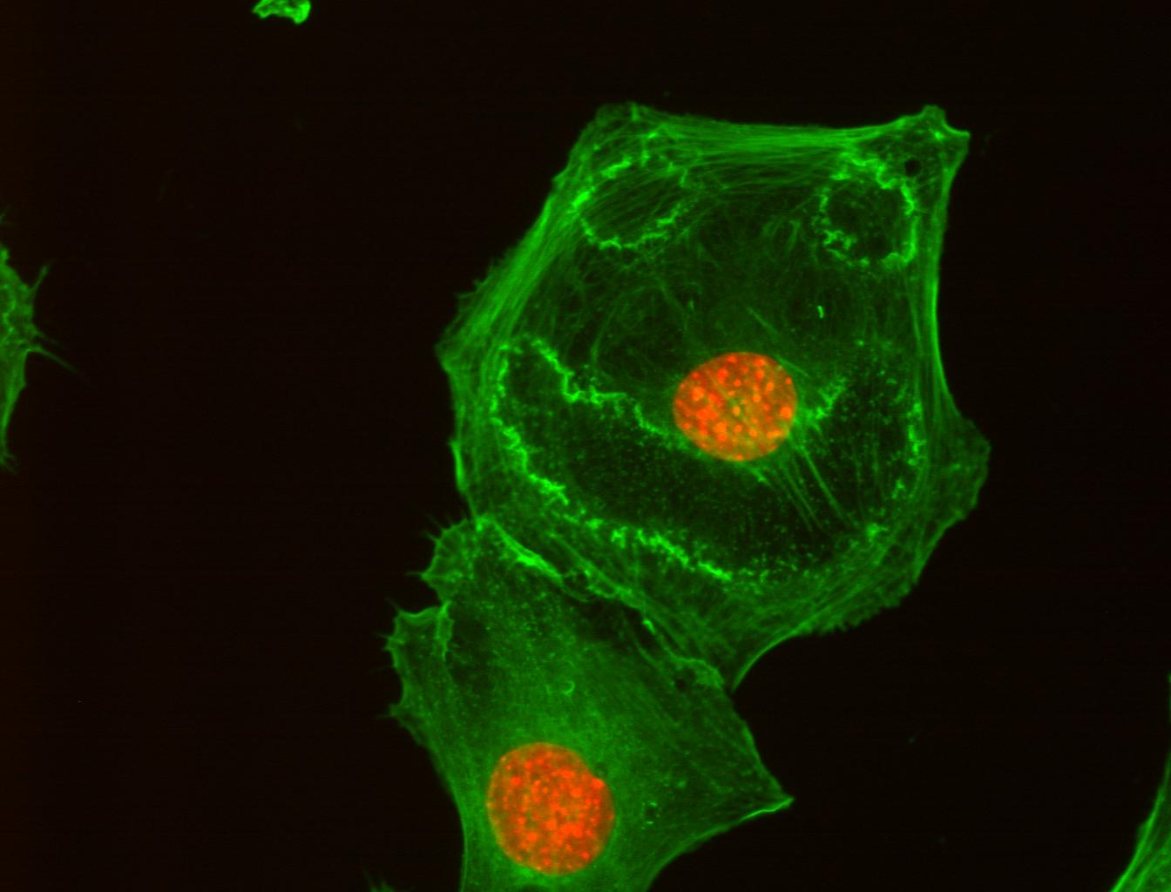
Thank you for your attention!
Thanks to Zeiss for the invitation!
Acknowledgements
ALMF team:
Beate Neumann
Sabine Reither
Volker Hilsenstein
Aliaksandr Halavatyi
Tobias Rassse
Stefan Terjung
Rainer Pepperkok
Ellenberg Team:
Antonio Politi
Jan Ellenberg
Green: actin cytoskeleton
Red: nucleus
Cells treated with PDGF

Slide 26
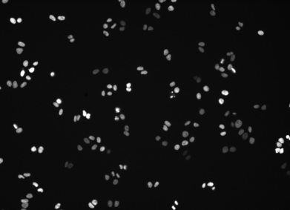
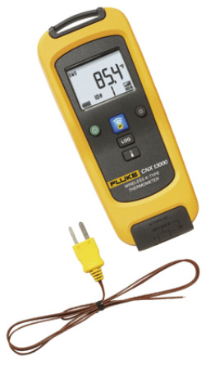
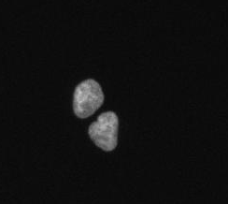
Environmental control
Zeiss CellDiscoverer 7, H2B-mCherry
10x every 30min, 48h
37C ?!
37C ?!
37C ?!
38C => visible mitotic defects
(e.g., increased mitotic index and micro-nuclei formation)
Cropped and enlarged view on above movie

Slide 27
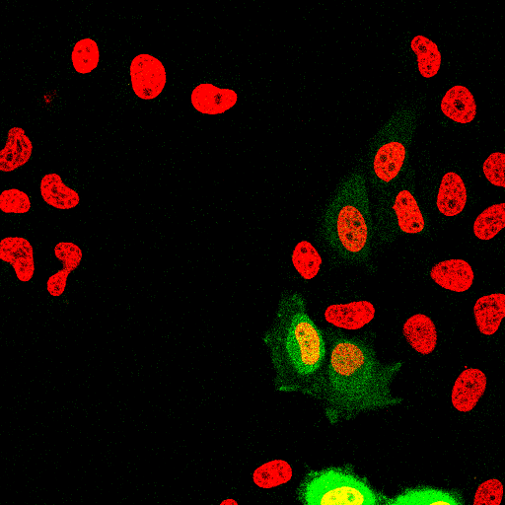
Automated FCCS screening of chromatin interaction of EYFP-tagged proteins, using Histone H2B-mCherry as a chromatin marker [2].
Move to next grid position
For each coordinate: acquire 30s FCCS
Leica confocal
Zeiss confocal
I(t)
t
Leica CAM Visual Basic
Tested 53 proteins.
=> For each protein:
~ 1,133 FC(C)S measurements
in 189 cells
Micropilot
ImageJ/Fiji
[1] Wachsmuth et al., High-throughput microscopy fluorescence correlation spectroscopy… (2014) Nature Biotechnology
[2] Conrad et al., MicroPilot: Automation of fluorescence microscopy … (2011) Nature Methods

Slide 28
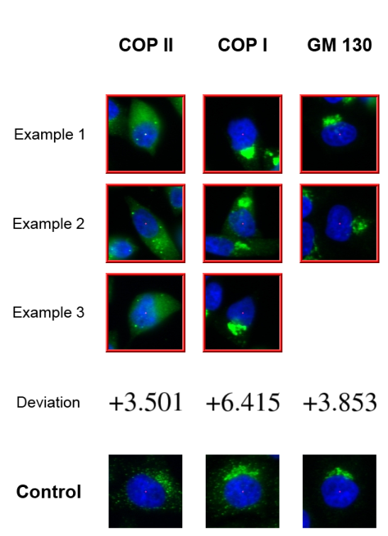
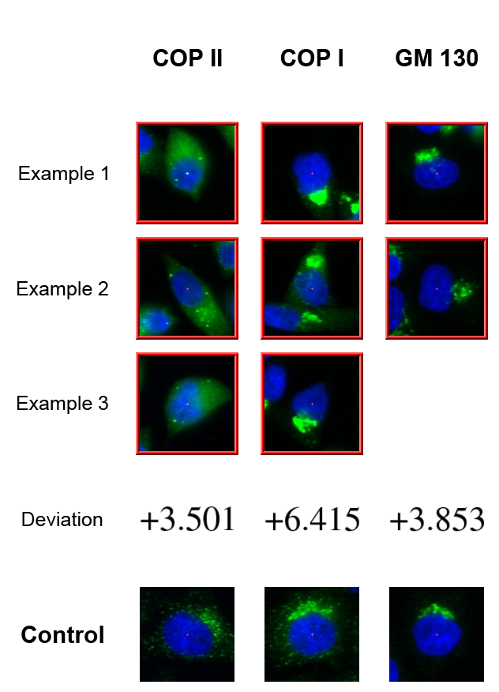
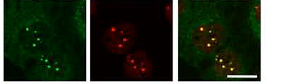
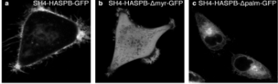
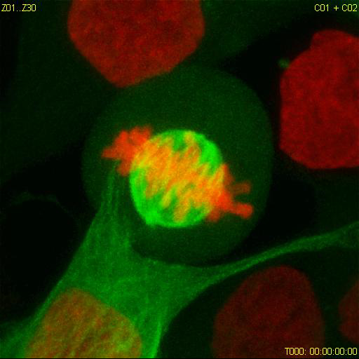
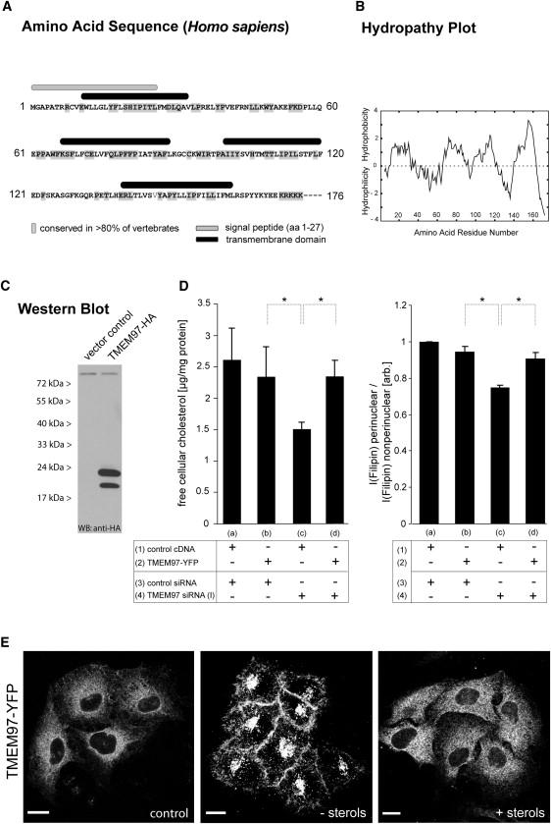
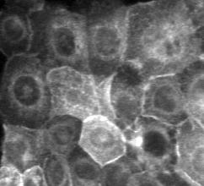
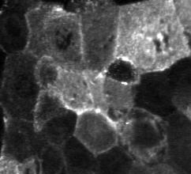

Completed HT-microscopy projects with ALMF support
Protein secretion / membrane
trafficking / organelle organisation
Simpson et al., Nat Cell Biol. 2012
DNA repair
Gudjonsson et al., Cell 2012
Lukas et al., Nat Cell Biol. 2011
Doyle et al., Cell. 2009
Plasma membrane targeting
Ritzerfeld et al., Genome Research 2011
Cell division
Neumann et al., Nature 2010
Cholesterol metabolism
Bartz et al, Cell Metab. 2009
Blattmann et al., PloS Genet 2013
Cystic Fibrosis
Almaca et al., Cell 2013
Inner membrane nuclear targeting
Boni et al. J Cell Biol 2015
Notes:
RNAi microarrays are Here you can see the summary of projects using RNAi microarrays.
All projects labelled in red were genome-wide screens.
These RNAi microarrays can be used for many different assays types as shown here.

Slide 29


Autophagosome formation screen
Control
Inhibition
Desired assay readout: fluorescence intensity in dot-like structures

Slide 31
What to measure
Mean vs Sum
Cell cycle example

Slide 32


Microscopy automation for FCS on chromatin binding factors
Autofocus on Histone 2B-mCherry
Find suitable cell:
- Nuclear shape
- Fluorescence levels
Generate coordinates
- 3 inside nucleus
- 3 inside cytplasm
For each coordinate acquire 30s FCS
Move to next position
Image
H2B-mCherry
Protein-YFP
Report to microscope:
- Object coordinates
- Laser intensity
- Exposure time
- …
HeLa cells stably expressing Histone2B-mCherry; transiently expressing different EYFP constructs
Leica Sp5 & FCCS
(CAM Interface)
Notify analysis software:
- path to images
Micropilot
{x,y}
I(t)
t
Malte Wachsmuth, Ellenberg Lab, EMBL HD
Notes:
Say:
For this project they were interested to find out whether proteins are interacting with Chromatin!
So they used a cell line stably expressing Histone 2B-mCherry which is bound to chromatin and co-expressed other YFP-tagged proteins
For this we used…
Malte:
- Autofocus on cells?
- Image of this?
What is the plate layout?
How do you do the transfection?
MicroPilot reports back the location of several cells in one image?
What are the cell selection criteria? Nuclear shape and GFP signal intensity?
It is Leica SP5 with Picoquant FCCS, right?
Can one also say Histone2B instead of H2B?
If you see a crosscorrelation with H2B-mCherry, what is the conclusion?
Direct Interaction with H2B-mCherry
Indirect Interaction due to Chromatin binding? (they wobble together on the DNA)
If both is possible, can we distinguish?
The fast Diffusion Coefficient of GATA3 and H2A is that in accordance with their size?

Slide 33






Automated FCCS on protein-chromatin interaction (3 examples from currently 53)
EYFP
H2B-mCherry
D₁ = 29.8 ± 0.2 µm²s⁻¹
f₂ = no significant 2nd component
CC = 1.02 ± 0.06%
(2172 measurements in 979 cells)
EYFP:
Only free diffusive
H2A-EYFP
H2B-mCherry
D₁ = 7.2 ± 0.5 µm²s⁻
D₂ = 0.28 ± 0.02 µm²s⁻¹ , f₂ = 24 ± 1%
CC = 44 ± 2%
(137 measurements in 74 cells)
Histone 2A:
Free and bound fraction
Chromatin interaction
GATA3-EYFP
H2B-mCherry
D₁ = 4.2 ± 0.5 µm²s⁻¹
D₂ = 0.19 ± 0.01 µm²s⁻¹ , f₂ = 35 ± 3%
CC = 18 ± 2%
(137 measurements in 74 cells)
GATA3 (transcription factor):
Free and bound fraction
Chromatin interaction
Malte Wachsmuth, Ellenberg Lab
Notes:
So far we imaged 53 constructs and here i show you 3 examples

Slide 34
Adaptive FCS Microscopy

Slide 35
High-throughput Screening Microscopy
“Primary” screen
Protein knockdown by siRNA
Monitor perturbation of biological process in microscopy assay
Biological process
Protein localization dynamics
Which proteins?
Protein-protein
Interaction dynamics
“Secondary” screen
“Secondary” screen
Notes:
You have an assay that tells you whether the process of interest is working and then you look in the presence of siRNAs whether the process is still working.

Slide 36


Low NA Transmission Imaging
Condenser Aperture
Celldiscoverer 7
logo
Image without shadows
Image without shadows

Slide 37
Adaptive Feedback Microscopy using ZEISS products
Microscope Examples | Zeiss Software | Open Application Development Modality | Image Analysis Modalities
LSM510 confocal (1) LSM780 confocal LSM880 confocal | ZEN Black | Visual Basic scripting with macro recording | Visual Basic or external software
LSM800 confocal CellDiscoverer 7 widefield | ZEN Blue | Python scripting with macro recording | ZEN Blue interal image analysis or external software
(1) Rabut and Ellenberg, Automatic real-time three-dimensional cell tracking by fluorescence microscopy. J. Microscopy, 2004

